Slide 1

Histone-Modifier Graph Transformer for Prognosis Prediction in Hepatocellular Carcinoma
Name : Surya Gayathri S
Roll No: AM.SC.P2ARI24014
Guided by: Dr. Geetha M

Slide 2
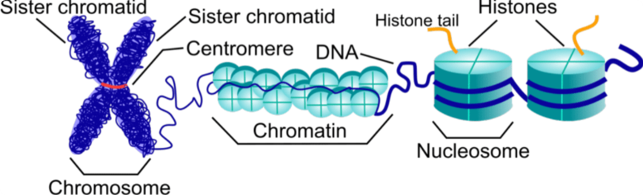
Introduction
Epigenetic regulation controls gene expression without altering the DNA sequence
It primarily acts through changes in chromatin structure
Histones play a key role in packaging DNA into chromatin
Modifications in histones determine whether genes are:
Active (accessible)
Inactive (condensed)

Slide 3
Introduction(Contd)
HCC is one of the most lethal malignancies with a 5-year survival rate below 20%
Epigenetic dysregulation is a hallmark of HCC — chromatin structure is systematically altered in tumour cells
Histone-modifying genes play a crucial role in cancer progression
HATs (add acetyl groups)
HDACs (remove acetyl groups)
HMTs/KDMs (add/remove methyl groups)
Existing prognostic models analyse genes individually, ignoring network interactions
This motivates studying gene relationships using network-based approaches and advanced models

Slide 4
Problem Definition
Hepatocellular carcinoma (HCC) has poor prognosis and limited early prediction methods
Gene expression-based studies often analyze genes independently, ignoring biological interactions
Histone-modifying enzymes act cooperatively in protein complexes — this co-regulation is not captured in existing models
Protein-protein interaction networks among histone modifiers remain unexplored in HCC prognosis
Complex gene-gene relationships that influence patient survival are lost in individual gene analysis
Current approaches lack the ability to model epigenetic network structure for survival prediction

Slide 5
Objectives
Extract histone-modifying genes from EpiFactors across 10 enzyme families
Construct a high-confidence PPI network using STRING v12
Integrate TCGA-LIHC RNA-seq expression with the PPI graph structure
Derive a LASSO-Cox prognostic gene signature and validate independence
Develop a Graph Attention Network trained with Cox partial likelihood loss
Identify key regulators via hub gene analysis and attention weight extraction
Evaluate using C-index, Kaplan-Meier curves, and multivariate Cox regression

Slide 6
Literature Review Summary
Title & YOP | Problem Addressed | Solution Approach | Research Gap
TransGNN: Global Contextual Representation via Graph-Transformer Fusion for HCC Prognosis in Whole-Slide Images (2024) nih | Local patch-based Hybrid GNN + Transformer model — GNN builds WSI graph for structural features, Transformer learns global context via self-attention nih methods miss global contextual features in HCC pathology images | Graph Transformer with directed structure encoding for GRN inference | Based on histopathological images, not RNA-seq gene expression; does not use PPI networks or histone-modifier biology
Multimodal Graph-Based Model for Discrete-Time Survival Prediction in Liver Cancer (2025) Frontiers | HCC survival prediction requires integrating heterogeneous histopathological and clinical data | Graph Attention Network aggregates WSI patch features; sentence transformer encodes clinical variables; fused via multimodal intermediate fusion on TCGA-LIHC Frontiers | Uses imaging and clinical data only; does not leverage gene expression, PPI interaction networks, or epigenetic gene families
Transformer-Based Deep Learning Survival Prediction in HCC via cGAS-STING Pathway (2025, Briefings in Bioinformatics) nih | Poor HCC survival prediction due to complex pathway interactions not captured by conventional models | Transformer survival model preserving raw pathway structure of cGAS-STING and correlated pathways, tested on HCC and colon cancer nih | Pathway-based Transformer without graph structure; does not model gene-gene PPI interactions or histone-modifier epigenetic networks

Slide 7
Research Gap
Reviewed graph-based HCC models use imaging or clinical data — not RNA-seq with PPI network structure
Histone-modifier genes treated as isolated features — cooperative network interactions not modelled
Reviewed models produce risk scores without biological interpretation of driving genes or pathways

Slide 8
Research Contributions
PPI-graph-integrated Graph Attention Network across 10 histone-modifier families for HCC survival prediction
56-gene LASSO-Cox epigenetic signature validated as independent prognostic factor
Risk stratification validated across 7 clinical subgroups including early-stage HCC
Attention weight framework identifying gene-level drivers of patient similarity
Triple convergence analysis on TP53-centred chromatin axis

Slide 9


Dataset Description
1. TCGA-LIHC (Liver Cancer Dataset)
Cancer Type: Hepatocellular Carcinoma (HCC)
Total RNA-seq samples: ~424 patients
Genes: 60,661
Provides: Gene expression profiles for model training
2. Survival Dataset (TCGA-LIHC.survival.tsv)
Size: ~424 patients × 3 variables
Key Features:
Overall Survival Time (OS.time)
Survival Status (OS.event)
Role: Survival analysis and model validation

Slide 10

Dataset Description(Contd)
3. STRING Protein Interaction Dataset
Interactions: ~13.7 million protein–protein interactions
Proteins: ~19,699 human proteins
Key Columns: protein1, protein2, combined_score
Role: Provides graph structure (biological network)
4. Supporting Datasets (for Data Integration):
GENCODE (gene_probemap): Converts ENSG IDs → gene symbols
STRING protein info: Converts protein IDs → gene names
EpiFactors v2.0: 801 histone-modifier proteins → Data integration and ID mapping

Slide 11
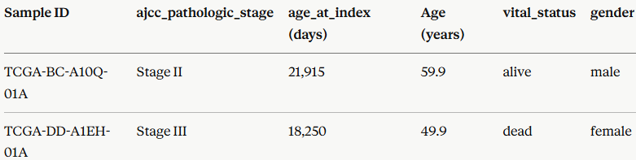
Dataset Description(Contd)
5. TCGA-LIHC Clinical
Size: 424 patients × 25+ clinical variables
Key columns used:
ajcc_pathologic_stage — tumour stage (Stage I / II / III / IV)
age_at_index — patient age in days at diagnosis (converted to years by dividing by 365.25)
vital_status — alive or dead at last follow-up
gender — male or female (used in subgroup analysis)
Role: Multivariate Cox regression — confirms risk score is an independent prognostic factor after adjusting for tumour stage and age

Slide 12
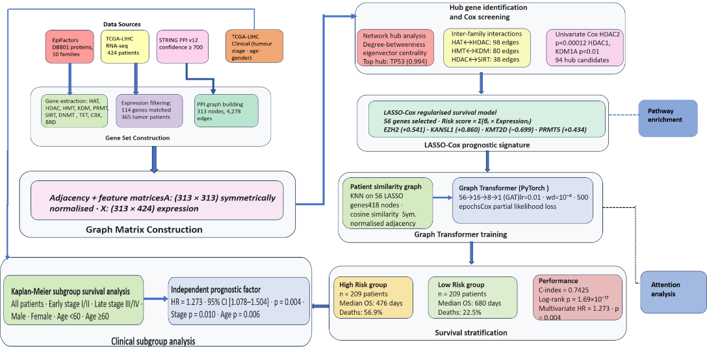
Design/Architecture

Slide 13
Methodology/Proposed Method
1. Gene Set Construction
Input: TCGA-LIHC RNA-seq (60,661 genes × 424 samples) · EpiFactors v2.0 · GENCODE gene map · STRING v12 PPI file
Convert ENSG IDs → HGNC gene symbols using GENCODE probe map
Remove duplicate and unmapped gene entries
Filter EpiFactors to 10 enzyme families: HAT · HDAC · HMT · KDM · PRMT · SIRT · DNMT · TET · CBX · BRD
Match filtered genes against TCGA expression matrix → 114 genes · 365 tumour patients
Convert STRING protein IDs → HGNC gene symbols using protein info mapping file
Filter STRING: retain only histone-modifier gene pairs · confidence score ≥ 700
Remove self-loops and duplicate edges
PPI graph: 313 nodes · 4,278 edges
Output: 114-gene expression matrix · PPI graph (313 nodes · 4,278 edges)

Slide 14
Methodology/Proposed Method(Cont)
2. Graph Matrix Construction
Input: PPI graph (313 nodes · 4,278 edges) · 114-gene expression matrix
Construct adjacency matrix A ∈ ℝ³¹³ˣ³¹³ from PPI graph edges
Construct feature matrix X ∈ ℝ³¹³ˣ⁴²⁴ from standardised TPM expression values
Add self-loops and apply symmetric normalisation:
Â = D⁻¹/²(A + I)D⁻¹/²
Output: Normalised adjacency matrix Â · standardised feature matrix X

Slide 15
Methodology/Proposed Method(Cont)
3. Hub Gene Identification and Cox Screening
Input: Normalised PPI graph G = (V, E) · |V| = 313 · survival data (OS.time · OS)
Compute four centrality metrics per gene g:
Degree d_g · Betweenness b_g · Eigenvector e_g · Weighted degree w_g
Normalise each metric to [0, 1]
hub_score_g = (d_g + b_g + e_g + w_g) / 4
Rank 313 genes · Top hub: TP53 (score = 0.994)
Inter-family: HAT↔HDAC 98 edges · HMT↔KDM 80 edges · HDAC↔SIRT 38 edges
Univariate Cox per gene: HDAC2 p = 0.00012 · HDAC1 · KDM1A p < 0.01
Output: 94 hub gene candidates · hub scores · inter-family edge statistics

Slide 16
Methodology/Proposed Method(Cont)
4. LASSO-Cox Prognostic Signature
Input: Expression matrix (94 hub genes × 418 patients) · survival data (OS.time · OS)
Apply LASSO-penalised Cox regression (CoxnetSurvivalAnalysis · l₁_ratio = 1.0)
Regularisation parameter λ tuned via cross-validation
Retain genes with non-zero coefficients at minimum penalisation
RS_j = Σ_{g∈S} β̂_g · x_gj
S = 56 selected genes · β̂_g = LASSO coefficient · x_gj = standardised expression of gene g in patient j
Stratify patients at median RS: High Risk · Low Risk
Output: 56-gene signature · per-patient risk scores · High Risk / Low Risk groups

Slide 17
Methodology/Proposed Method(Cont)
5. Graph Transformer Training
Input: 418 patients × 56 LASSO genes (standardised) · survival data (OS.time · OS)
Construct KNN patient similarity graph using cosine similarity:
Cosine(i,j) = (vᵢ · vⱼ) / (‖vᵢ‖ × ‖vⱼ‖)
Symmetrise and normalise patient adjacency: Â_S = D_S⁻¹/²(A_S + I)D_S⁻¹/²
Graph Attention Network: 56 → 16 → 8 → 1
Attention: α_ij = softmax(LeakyReLU(aᵀ[Wh_i ‖ Wh_j]))
Node update: h_i' = ReLU(Σ_{j∈N(i)} α_ij · W · h_j)
Output layer: risk_i = wᵀ · h_i'' + b
Dropout p = 0.3 after each GAT layer
Cox partial likelihood loss: L = −Σ_{i:δᵢ=1} [rᵢ − log Σ_{j:tⱼ≥tᵢ} exp(rⱼ)]
Optimiser: Adam · lr = 0.01 · weight decay = 10⁻⁴ · 500 epochs
Output: Trained GAT model · predicted risk score per patient

Slide 18
Methodology/Proposed Method(Cont)
6. Survival Analysis and Clinical Validation
Input: Risk scores (LASSO-Cox · GAT) · survival data (OS.time · OS) · TCGA-LIHC clinical variables (stage · age · gender)
Harrell C-index: C = (concordant pairs + 0.5 × tied pairs) / total comparable pairs
Kaplan-Meier curves with log-rank test: High Risk vs Low Risk
Multivariate Cox: risk score + tumour stage (III/IV = 1 · I/II = 0) + age (normalised)
Validate across 7 subgroups: All · Stage I/II · Stage III/IV · Male · Female · Age <60 · Age ≥60
Attention weight extraction: Pearson r(α_ij · sim_g(i,j)) per gene g
Pathway enrichment: 56 LASSO genes → Enrichr (KEGG · MSigDB Hallmark · Reactome)
Output: C-index · log-rank p · KM curves · HR · subgroup table · pathway enrichment table

Slide 19
Evaluation Metrics
Harrell C-index — measures how well the model ranks patients by predicted survival risk (range 0.5–1.0; this work: 0.7478)
Kaplan-Meier Survival Curves — visualises survival probability over time for High Risk vs Low Risk groups with log-rank test significance (p = 4.34×10⁻¹⁶)
Multivariate Cox Regression — confirms the risk score as an independent prognostic factor after adjusting for tumour stage and age (HR = 1.273, p = 0.004)
Clinical Subgroup Validation — evaluates model robustness across 7 subgroups (Stage I/II, Stage III/IV, Male, Female, Age <60, Age ≥60, All patients)

Slide 20
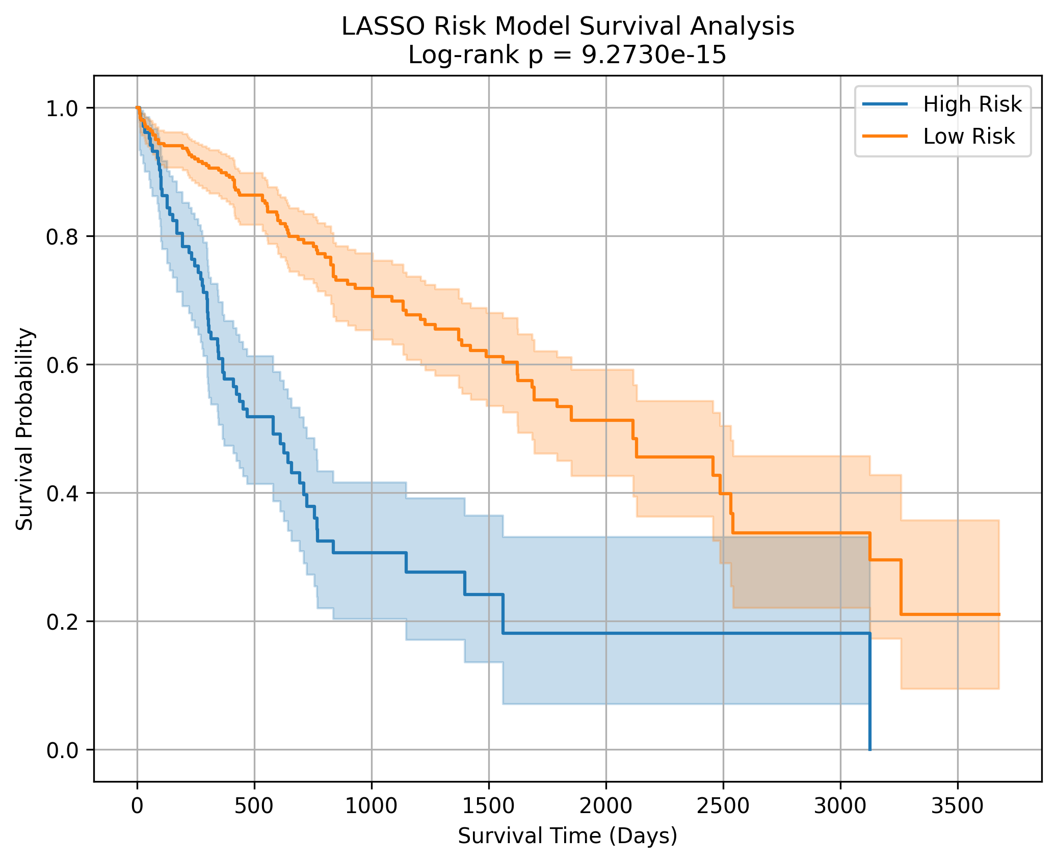
Result Analysis
LASSO-Cox Gene Signature Performance
56 genes selected
C-index = 0.7478
Log-rank p = 4.34×10⁻¹⁶
High Risk: n=101, Median OS = 373 days, Deaths = 60.4%
Low Risk: n=264, Median OS = 672 days, Deaths = 26.5%

Slide 21
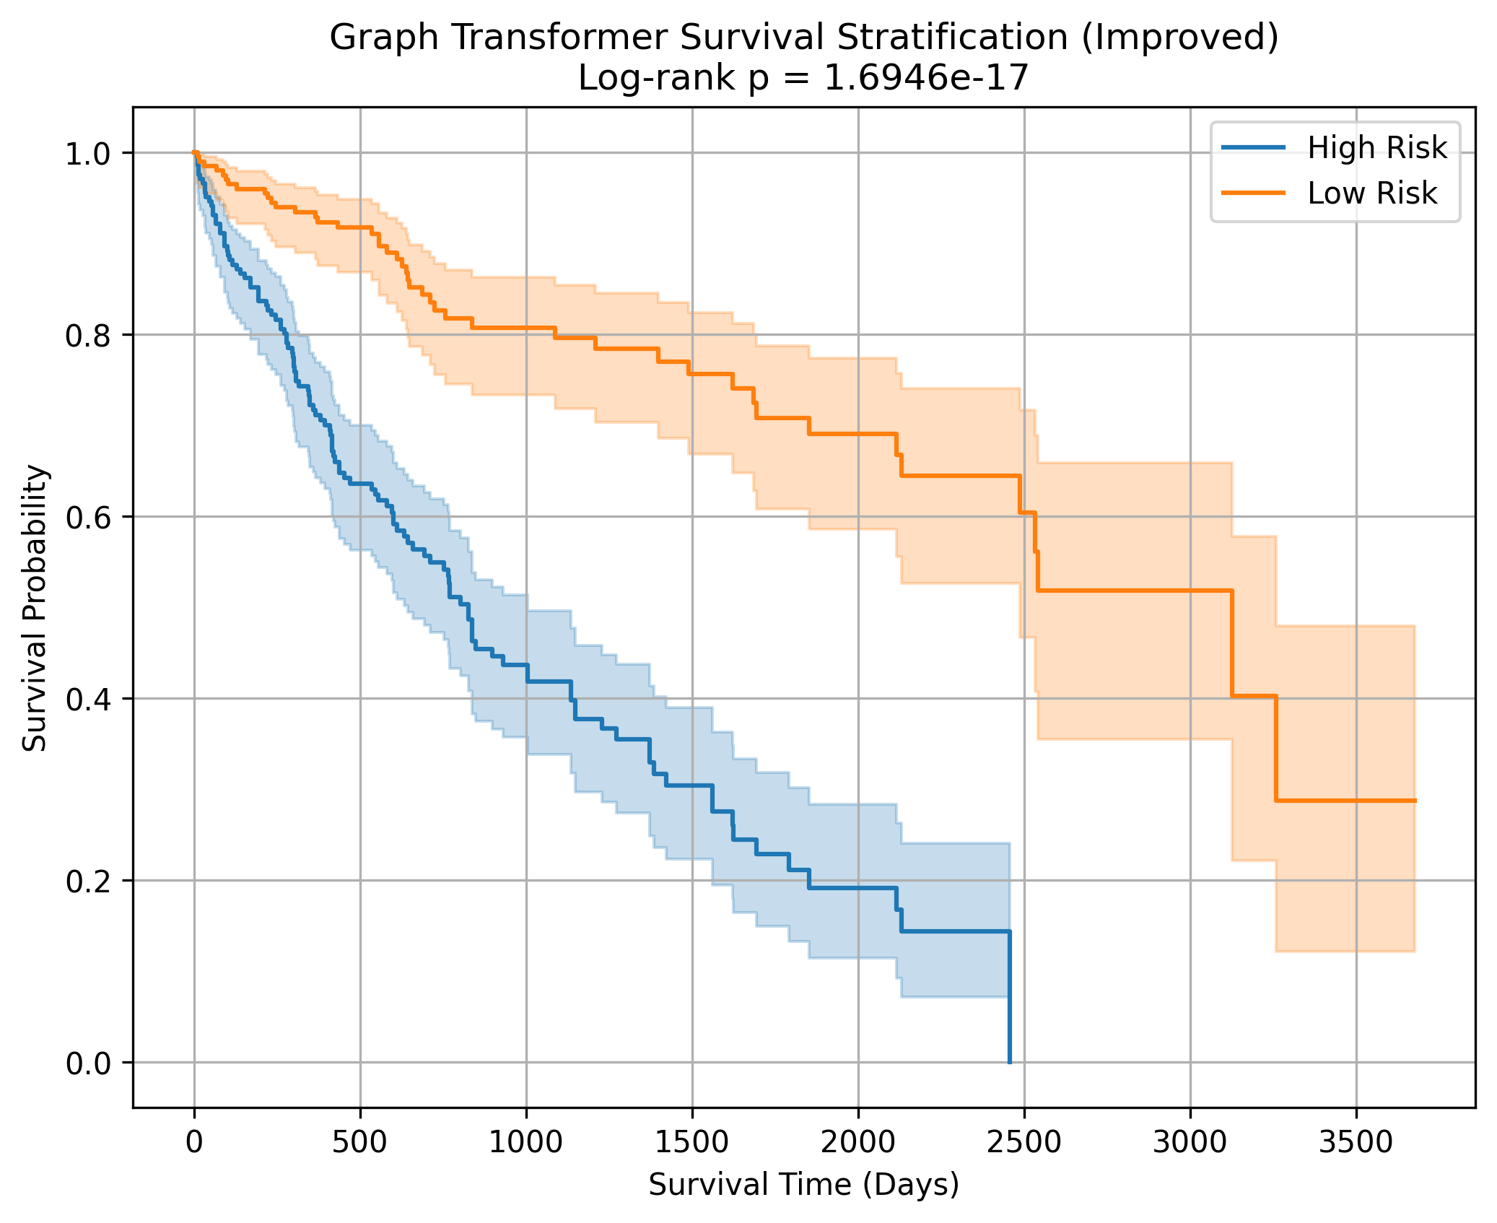
Result Analysis
Graph Transformer Survival Stratification
C-index = 0.7425
Log-rank p = 1.69×10⁻¹⁷
High Risk: n=209, Median OS = 476 days, Deaths = 56.9%
Low Risk: n=209, Median OS = 680 days, Deaths = 22.5%

Slide 22
Result Analysis
Clinical Subgroup Validation
Subgroup | High n | Low n | Log-rank p
All patients | 101 | 264 | 4.34×10⁻¹⁶
Early Stage I/II | 61 | 193 | 1.83×10⁻⁹
Late Stage III/IV | 34 | 53 | 2.50×10⁻⁵
Male | 72 | 174 | 2.47×10⁻¹¹
Female | 29 | 90 | 2.56×10⁻⁶
Age < 60 | 51 | 114 | 7.54×10⁻⁸
Age ≥ 60 | 48 | 149 | 1.18×10⁻⁸

Slide 23
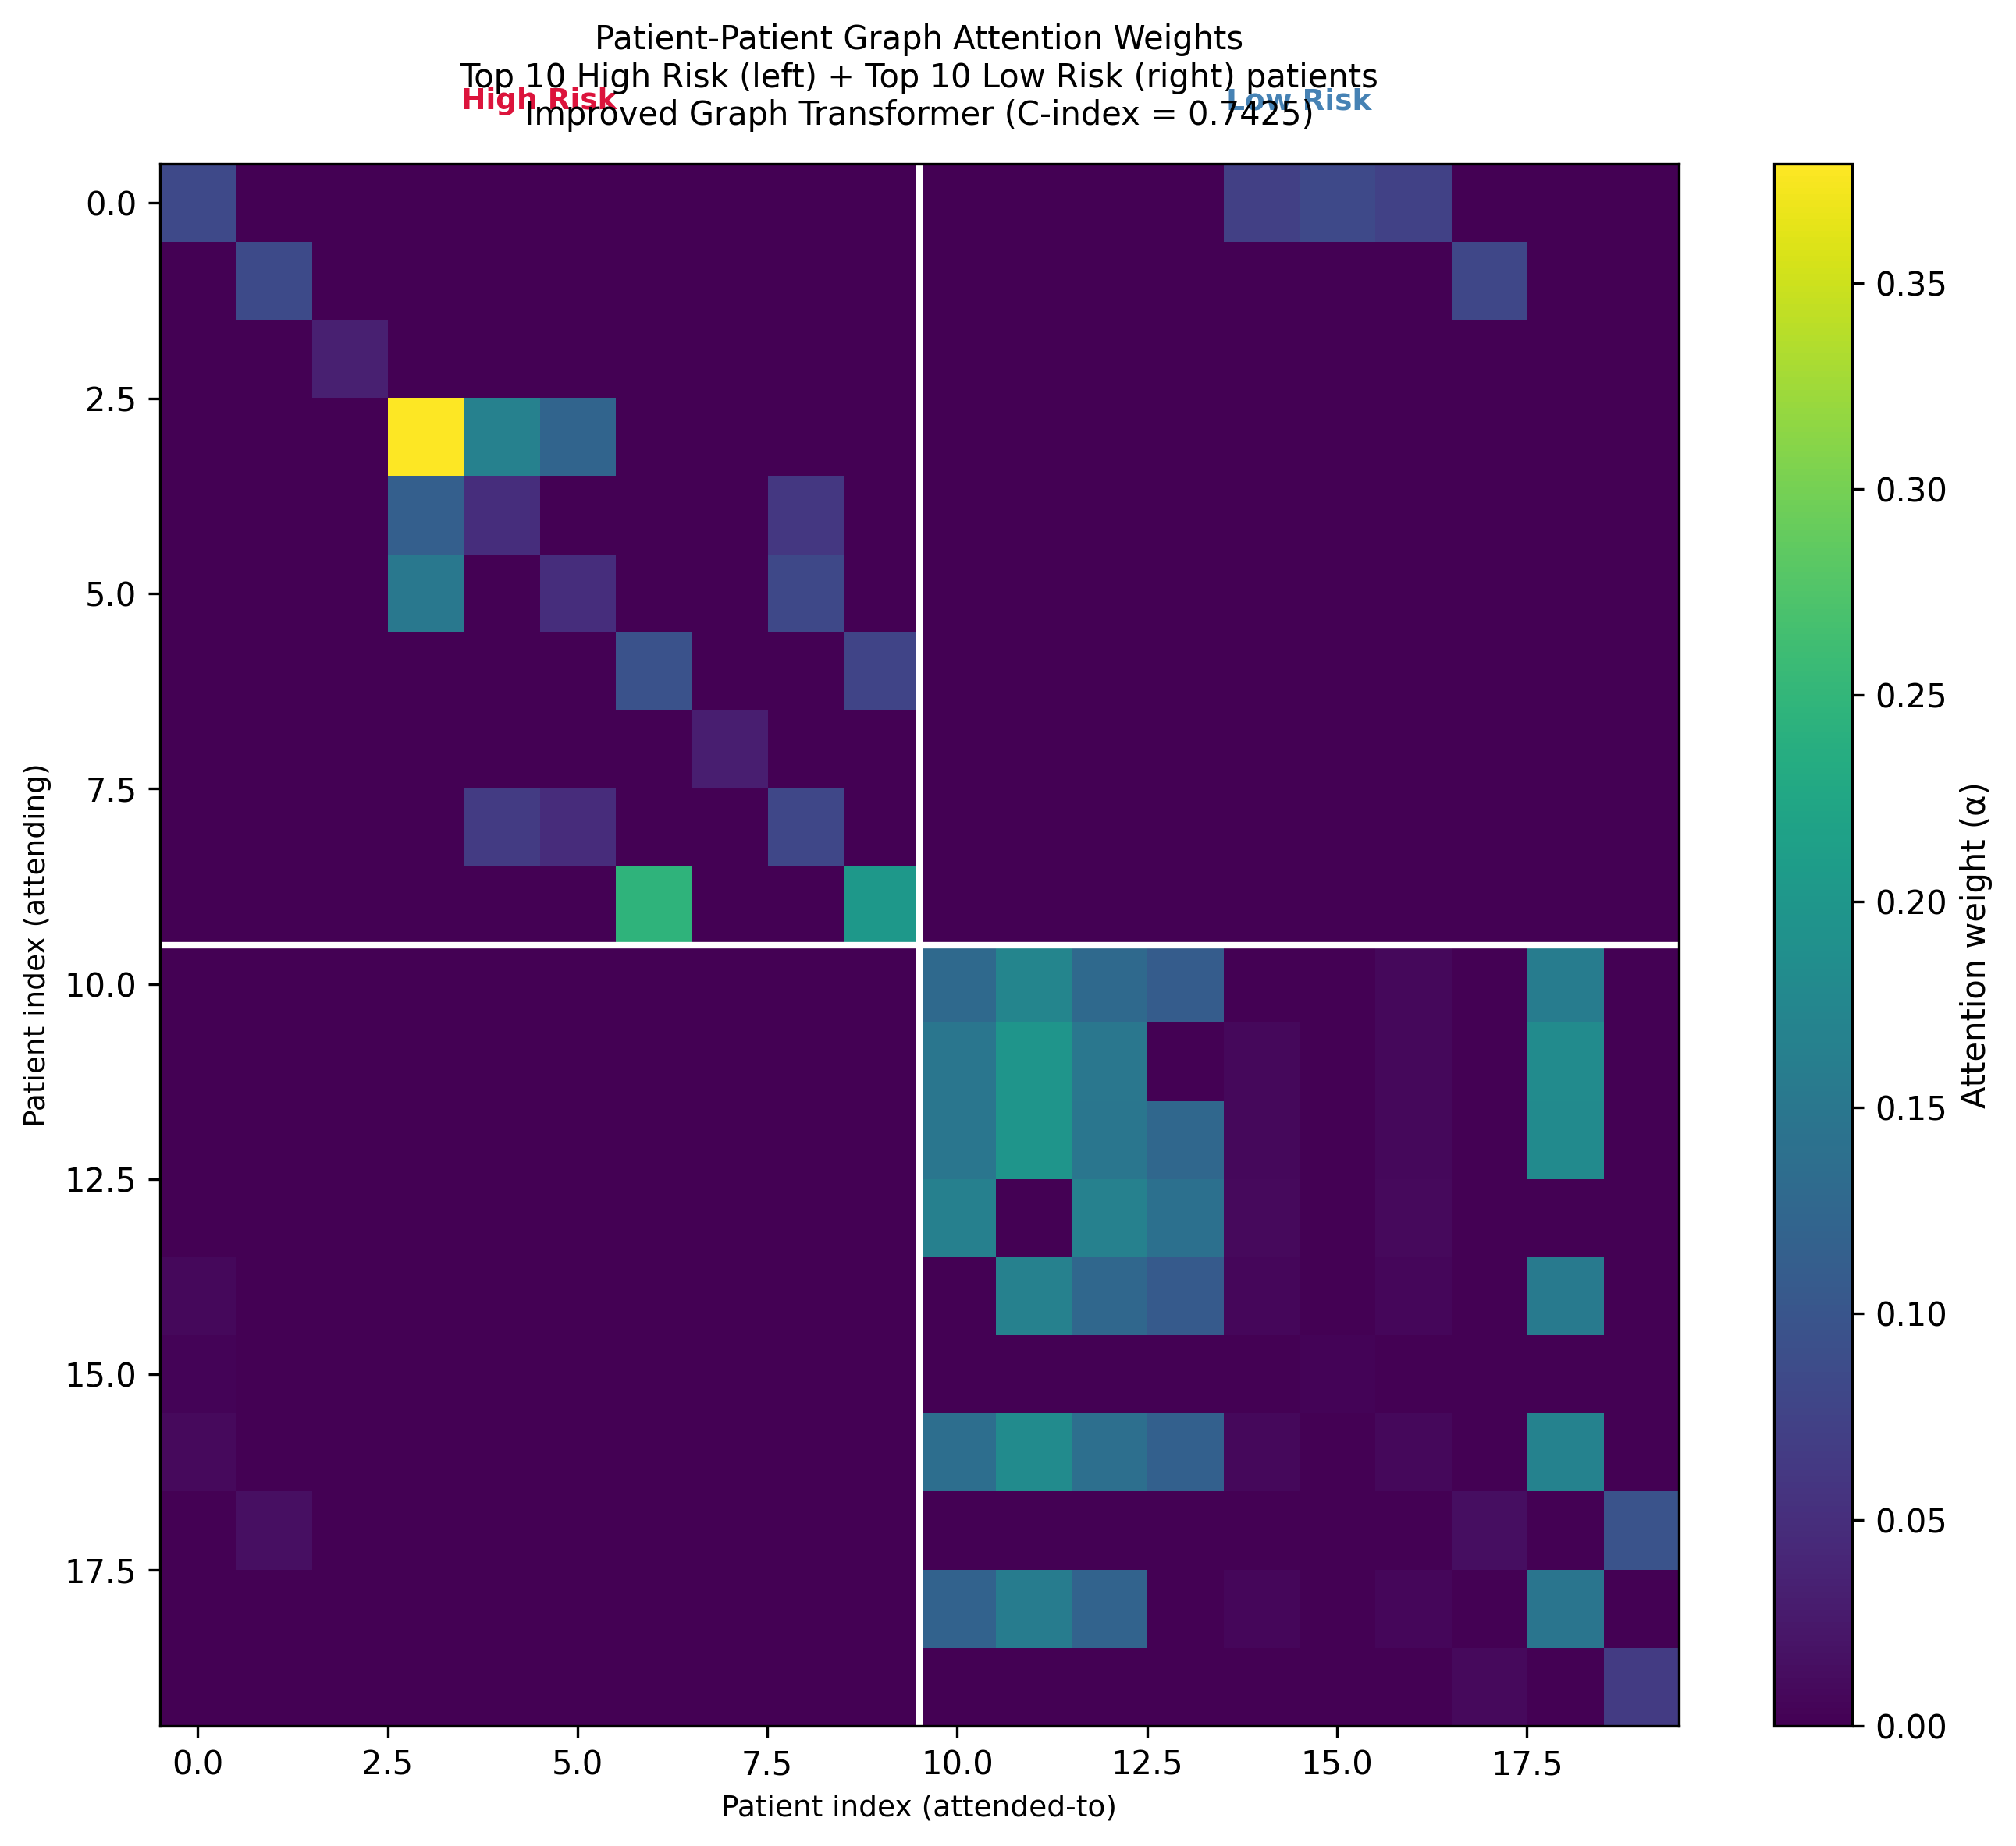
Result Analysis
Attention Weight Analysis
High→High attention: 0.003324 (2.3× cross-group)
Low→Low attention: 0.003671 (3.3× cross-group)
Top attention-driving genes: CDK1, NCOA6, EZH2, KMT2D, KANSL1

Slide 24
Pathway Enrichment
Pathway | Overlap | Hazard Ratio (HR)
Chromatin Modifying Enzymes | 41/238 | 1.67×10⁻⁶⁵
HATs Acetylate Histones | 20/106 | 2.75×10⁻³⁰
Regulation of TP53 Activity | 17/157 | 3.01×10⁻²¹
Epigenetic Regulation of Gene Expression | 13/116 | 2.56×10⁻¹⁶
Cell Cycle (KEGG) |  | 6.62×10⁻⁷

Slide 25
Ablation Study
Model | Architecture Source | C-index | Log-rank p
LASSO-Cox (Li et al. 2022) | Linear survival baseline | 0.7289 | 6.44×10⁻⁷
MLP + Cox loss (Cox-nnet, Zhan et al. 2021) | Deep survival, no graph | 0.4288 | 1.11×10⁻³
GCN + Cox loss (Geometric GNN, 2023) | Graph survival, no attention | 0.4098 | 4.75×10⁻³
HisGT-HCC (proposed) | GAT (Veličković et al. 2018) adapted for HCC survival | 0.7425 | 1.69×10⁻¹⁷

Slide 26
Conclusion
Developed HisGT-HCC — a histone-modifier Graph Transformer pipeline for HCC overall survival prediction using TCGA-LIHC RNA-seq data
Expanded gene coverage from 4 to 10 enzyme families (HAT · HDAC · HMT · KDM · PRMT · SIRT · DNMT · TET · CBX · BRD) across 114 genes and a 313-node PPI graph
Derived a 56-gene LASSO-Cox prognostic signature achieving C-index = 0.748 and log-rank p = 4.34×10⁻¹⁶ — confirmed as an independent prognostic factor (HR = 1.273, p = 0.004)
Graph Transformer matched LASSO-Cox discrimination (C-index = 0.7425) while providing attention-based biological interpretability
Risk signature achieved significant survival stratification across all 7 clinical subgroups including early-stage patients (p = 1.83×10⁻⁹) where conventional staging fails
Three independent analyses — network hub score, attention weights, and pathway enrichment — converge on a TP53-centred chromatin regulatory axis as the core epigenetic driver of HCC prognosis

Slide 27
Future Work
Validate the 56-gene signature on independent RNA-seq HCC cohorts such as ICGC LIRI-JP once data access is restored via ICGC ARGO
Replace transductive GAT with inductive architectures (GraphSAGE, inductive GAT) to enable risk scoring of new patients without retraining
Expand the gene set to include chromatin remodelling complexes (SWI/SNF, NuRD) and histone reader proteins (bromodomain, chromodomain families)
Experimentally validate top prognostic genes (EZH2, KANSL1, KMT2D) and the TP53-chromatin axis findings through in vitro HCC cell line studies
Explore clinical translation — develop epigenetic biomarker panels for patient stratification in HDAC, EZH2, and PRMT5 inhibitor clinical trials

Slide 28
Reference
D. Lee, Y. Kim, C. Park, et al., "Learning the histone codes with large genomic windows and three-dimensional chromatin interactions using transformer," Nature Communications, vol. 13, no. 1, Art. no. 6678, 2022.
J. Zhang, S. Liu, et al., "Differential gene expression prediction by ensemble deep networks on histone modification data," IEEE/ACM Transactions on Computational Biology and Bioinformatics, vol. 20, no. 1, pp. 340–352, 2023.
X. Chen, Y. Li, et al., "KAS-former: A transformer-based model for predicting histone modifications using KAS-seq," in Proc. IEEE Int. Conf. Bioinformatics and Biomedicine (BIBM), 2024, pp. 623–630.
A. E. Murphy, A. Askarova, B. Lenhard, N. G. Skene, and S. J. Marzi, "Predicting gene expression from histone marks using chromatin deep learning models depends on histone mark function, regulatory distance and cellular states," Nucleic Acids Research, vol. 53, no. 4, 2025.
Castelló-Uribe et al., "AttentionGRN: A functional and directed graph transformer for gene regulatory network reconstruction," Bioinformatics, 2025.
L. Tang, S. Diao, C. Li, et al., "Global contextual representation via graph-transformer fusion for hepatocellular carcinoma prognosis in whole-slide images," Computers in Medical Imaging and Graphics, vol. 115, Art. no. 102378, 2024.

Slide 29
Thank You

